Slide 1
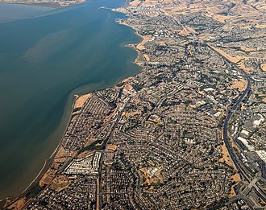
City of Pinole Background Information on Vacant Parcel Tax
City Council Meeting
September 5, 2023

Slide 2
Staff Recommendation
City staff recommends that the City Council receive a report of background information on vacant parcel tax and provide direction as appropriate.

Slide 3
What is a Vacant Parcel Tax?
Vacant parcel tax is a special, non-value based tax on real property, generally based on either a flat per-parcel rate or a variable rate depending on the size, use or number of units on the parcel.
Levied on residential, condominium, nonresidential/commercial , undeveloped land.
The allowable uses may be broad or narrow.
The tax must identify which services or facilities the tax proceeds may be used to fund.
Possible uses include police and fire services, parks and open space, infrastructure improvement, and libraries.
Because a vacant parcel tax is a special tax, it must be approved by a two-thirds vote of the electorate.

Slide 4
Considerations
Two main issues
City Council would need to determine what services would be funded by the tax
City Council would need to decide if the purpose of the tax is to raise money or make sure property is put to use
Other Considerations
Experience with vacant parcel taxes very limited
Significant lag in collecting the tax
Exemptions

Slide 5
Other Jurisdictions with Vacant Parcel Tax – City of Oakland
“Vacant Property Tax” passed in 2018
Special tax intended to fund services to support and reduce homelessness, affordable housing, and illegal dumping
Levies an annual tax of $3,000 to $6,000 on vacant property, which is property in use less than 50 days in a calendar year.
Generates approximately $5.5 million annually
Ordinance includes some exemptions
Property Type | Tax Rate
Residential | $6,000 per parcel
Condominium, duplex, or townhome unit under separate ownership | $3,000 per vacant residential unit
Nonresidential | $6,000 per parcel
Parcel with ground floor commercial activity allowed but vacant | $3,000 per parcel
Undeveloped | $6,000 per parcel

Slide 6
Other Jurisdictions with Vacant Parcel Tax – City of Berkeley
“Empty Homes Tax” passed in 2022
General tax intended to fund general municipal services
Levies an annual tax of $3,000 to $12,000 on vacant residential units, which is property that remains vacant more than 182 days in a calendar year
Expected to generates approximately $4-$6 million annually
For the first calendar year, the vacancy tax levies $3,000 per unit for the property owner’s first property and $6,000 per unit for any additional properties.
After one calendar year, the range doubles to $6,000 per unit and $12,000 per unit and is subject to inflation.
Ordinance includes some exemptions

Slide 7
Next Steps
Consulting firm, Baker Tilly, to assist with identifying local tax options
City Council direction to staff

Slide 8
Thank You
Questions/Comments?

